Slide 1
Support Vector Machines
Boston University CS 506 - Lance Galletti

Slide 2
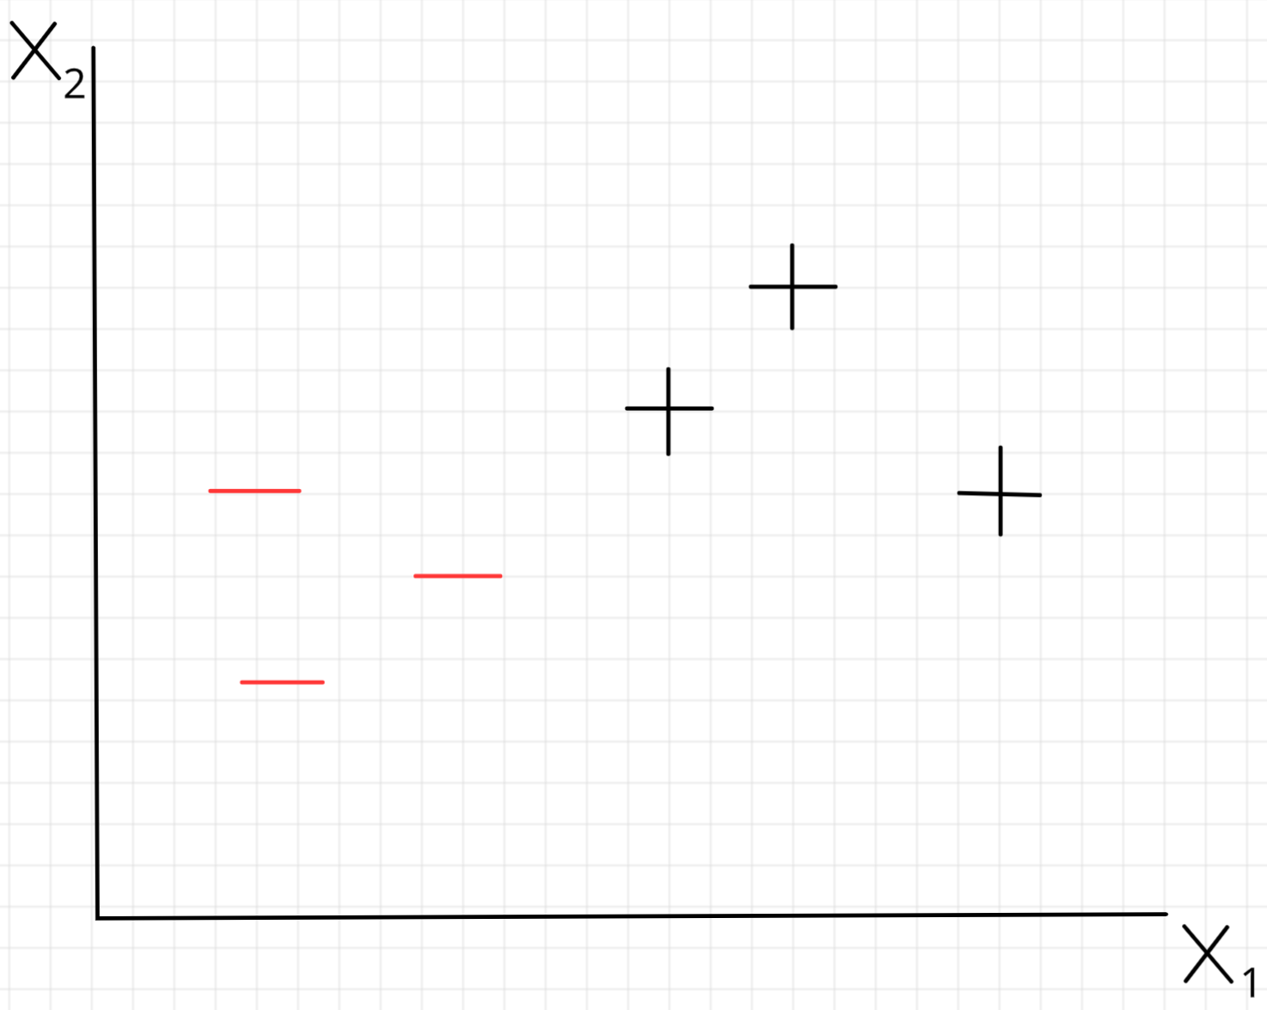
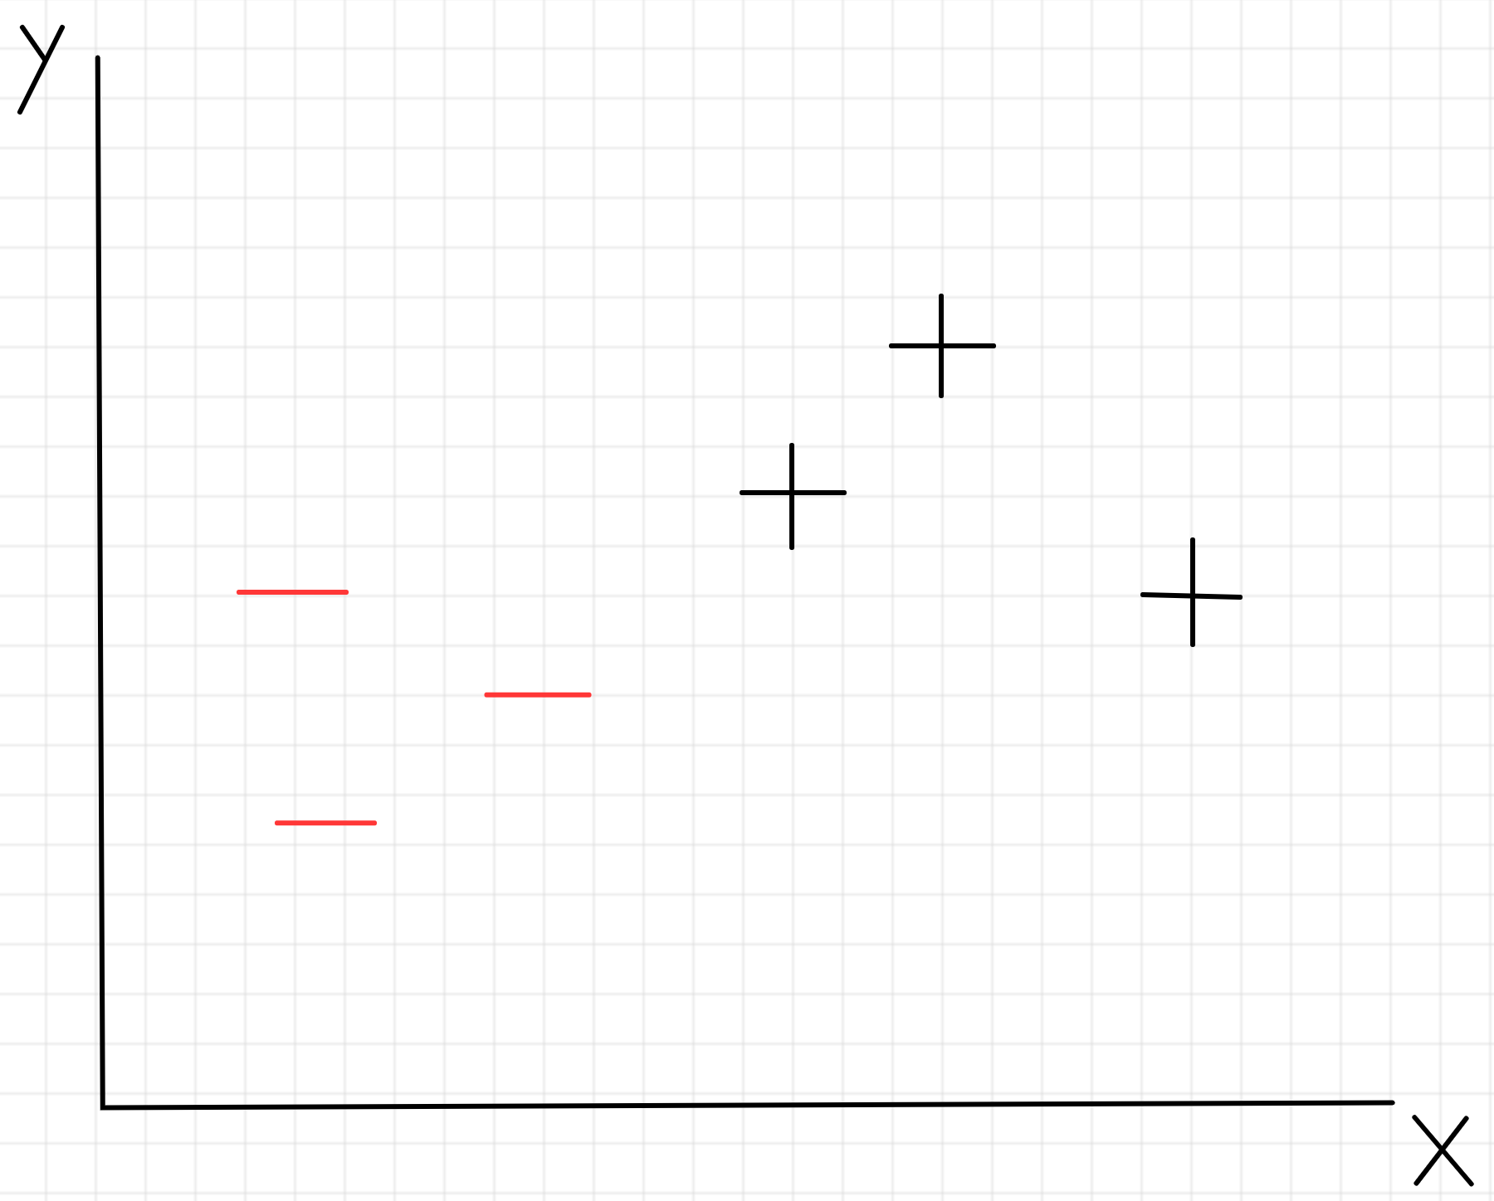

Slide 3
Decision Tree split on attribute x1

Slide 4
Nearest Neighbor decision boundary

Slide 5
Find the best line that separates our classes
?

Slide 6
SVM: Find the widest street that separates our classes - the dotted line in the middle is our decision boundary

Slide 7
Suppose we found this decision boundary, how would we classify an unknown input u?
u

Slide 8
Suppose we found this decision boundary, how would we classify an unknown input u?
Let w be a vector perpendicular to the decision boundary
w
u

Slide 9
Suppose we found this decision boundary, how would we classify an unknown input u?
We could project u onto w and depending on the size of that projection (which side of the street it ends up on), we can classify it as + or -
Let w be a vector perpendicular to the decision boundary
w · u

Slide 10
Suppose we found this decision boundary, how would we classify an unknown input u?
In math terms:
Or:
w · u

Slide 11
Just need to find w and b.
Questions:
Lots of w’s perpendicular to the street - which is the best one?
What is b?
DECISION RULE
w · u

Slide 12

How to find the widest street
We want our samples to lie beyond the street. That is:
Note: for an unknown u, we can have

Slide 13
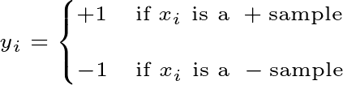
How to find the widest street
Let’s introduce a variable
Note: this is effectively the class label of

Slide 14
How to find the widest street
If we multiply our sample decision rules by this new variable:
Meaning, for on the decision boundary, we want:

Slide 15
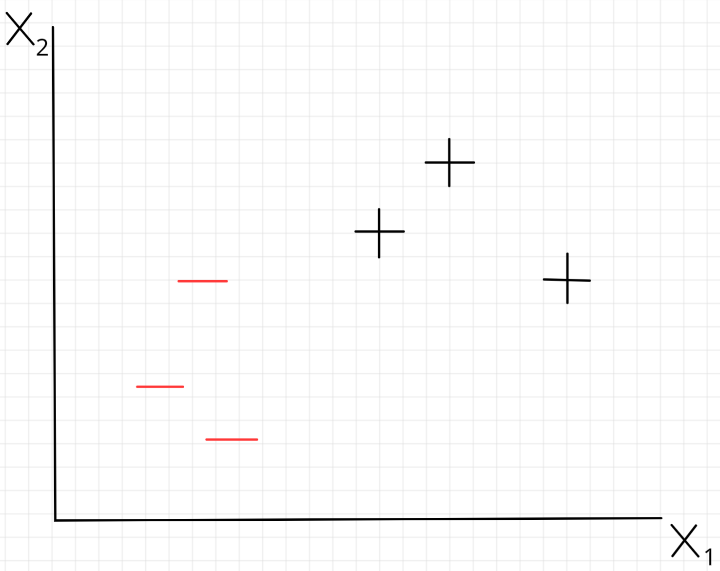
For and
points on the boundary

Slide 16

WIDTH
WIDTH
w

Slide 17

How to find the widest street
We know that WIDTH
And, since they are on the boundary, we know that
Hence, WIDTH
(as an exercise, try to show this)
for and points on the boundary

Slide 18
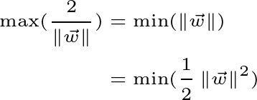
How to find the widest street
Goal is to maximize the width
Subject to:

Slide 19
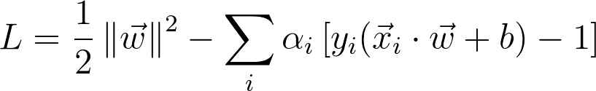
How to find the widest street
Can use Lagrange multipliers to form a single expression to find the extremum of
where is 0 for not on the boundary.
Now we can take derivatives to find the extremum of L.

Slide 20
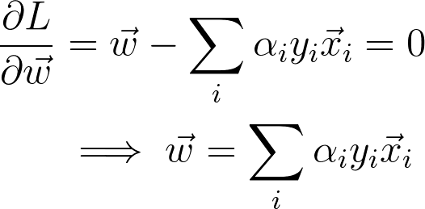
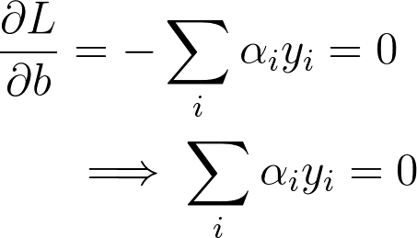
How to find the widest street
Means w is a linear sum of vectors in our sample/training set!

Slide 21
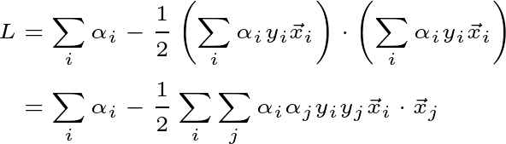
How to find the widest street
Let’s plug these values back into L to see what happens to L at its extremum
Simplifying, we get:

Slide 22

DECISION RULE
u

Slide 23
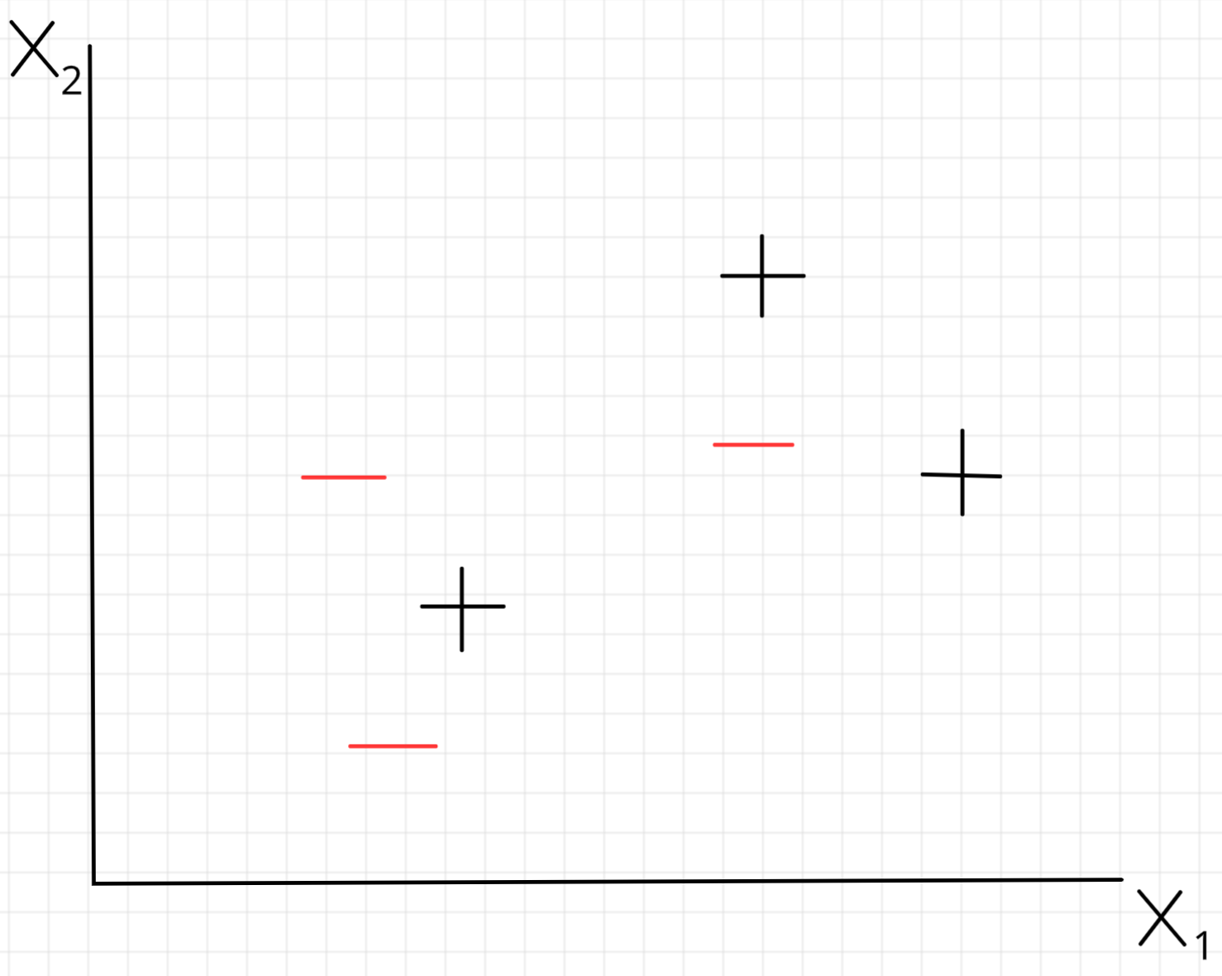
?

Slide 24
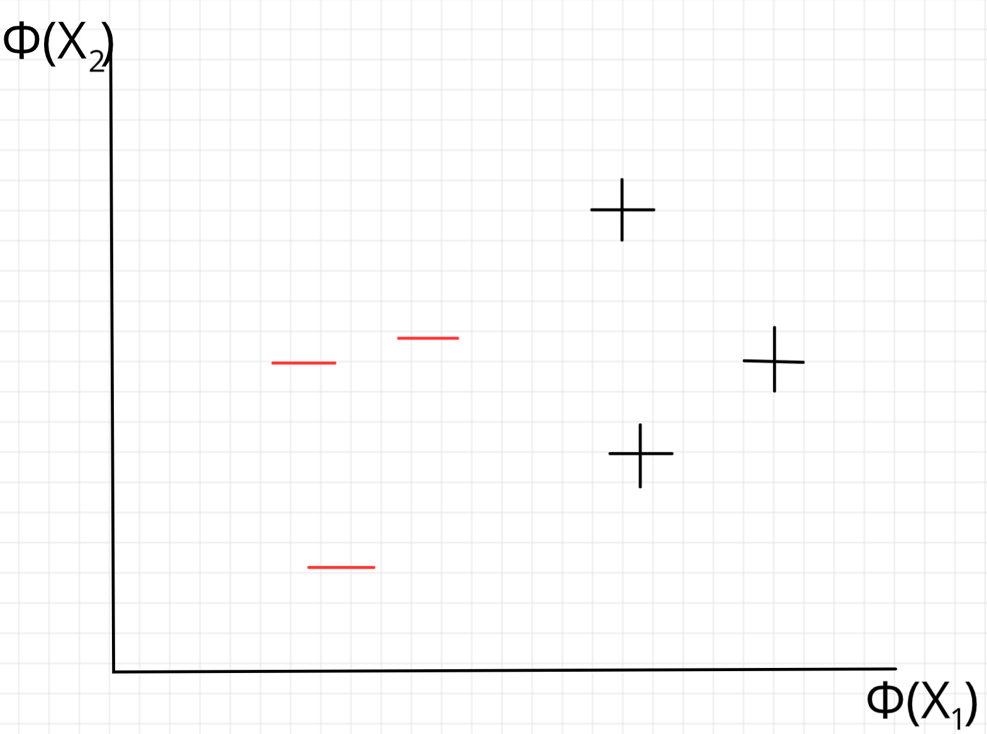
When stuck - change perspective
Φ

Slide 25
But how to find Φ?
Turns out we don’t need to find or define a transformation Φ!
Looking back at L, since it depends only on the dot product of our input, we only need to define the dot product in our transformed space.
i.e. we only need to define
Called a Kernel function. This is often referred to as the “kernel trick”.

Slide 26

Example Kernel Functions

Slide 27
DEMO

